Slide 1

Diabetes and Retinopathy Classification: A Multi-Modal Approach
Predicting Diabetes and Retinopathy with Tabular and Image Data
Team Members: Ajay, Deepak, Musharraf
Notes:
Good evening, everyone. Today, we’re excited to present our project titled 'Diabetes and Retinopathy Classification: A Multi-Modal Approach.' Our goal was to use both tabular and image datasets to predict diabetes status and retinopathy severity, combining machine learning and deep learning approaches. My name is Musharraf, and my teammates are Ajay and Deepak.

Slide 2

Why This Project Matters
Diabetes is a growing global health challenge, requiring timely diagnosis to prevent complications like diabetic retinopathy (DR).
Objective: Build predictive models to classify individuals as Non-diabetic, Pre-diabetic, or Diabetic based on health indicators.
Importance:
Supports early diagnosis and treatment.
Highlights key health and visual factors associated with diabetes.
Notes:
Diabetes is a significant global health challenge, affecting millions worldwide. Early diagnosis is crucial to prevent severe complications, including diabetic retinopathy, which can lead to blindness. In this project, we aimed to develop predictive models to classify individuals as Non-diabetic, Pre-diabetic, or Diabetic based on health indicators and predict retinopathy severity using retinal images. This approach not only supports early diagnosis but also highlights critical health and visual factors associated with diabetes.

Slide 3
Our Data Sources
Tabular Dataset:
Health indicators like BMI, Blood Pressure, Physical Activity, and Smoking status.
Target Classes: Non-diabetic (0), Pre-diabetic (1), Diabetic (2).
Samples: 253,680 (with SMOTE for class balancing)
Image Dataset:
Retinal images for diabetic retinopathy classification.
0: No DR
1: Mild
2: Moderate
3: Severe
4: Proliferative DR
5% sample used for computational efficiency
Notes:
Our project leveraged two datasets. The first was a tabular dataset containing health indicators such as BMI, Blood Pressure, and Physical Activity, with the target classes being Non-diabetic, Pre-diabetic, and Diabetic. The second was an image dataset of retinal images labeled by retinopathy severity, ranging from No DR to Proliferative DR. Together, these datasets allowed us to explore diabetes and its complications holistically.

Slide 4
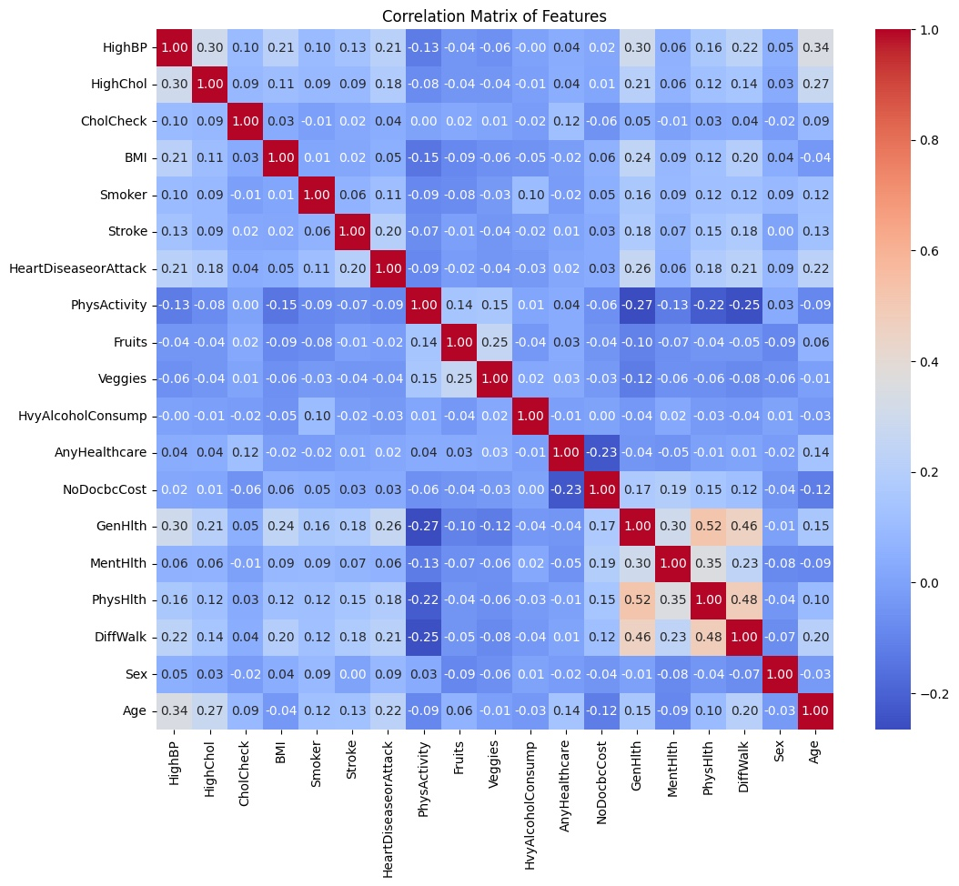
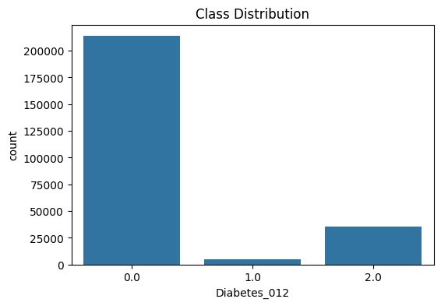
Understanding the Data
Tabular Dataset Insights:
Class distribution visualization shows imbalance (most samples are Non-diabetic).
Correlation heatmap reveals strong relationships between BMI, HighBP, and diabetes.
BMI and HighBP are higher in diabetics, while Physical Activity is lower.
Notes:
In the tabular dataset, we noticed a significant class imbalance, with most samples belonging to the Non-diabetic class. A correlation heatmap revealed strong relationships between features like BMI and High Blood Pressure. For example, individuals with higher BMI and Blood Pressure were more likely to be diabetic. These insights guided our feature selection and model development.

Slide 5
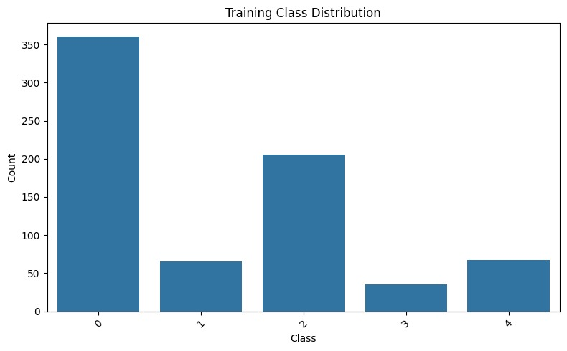
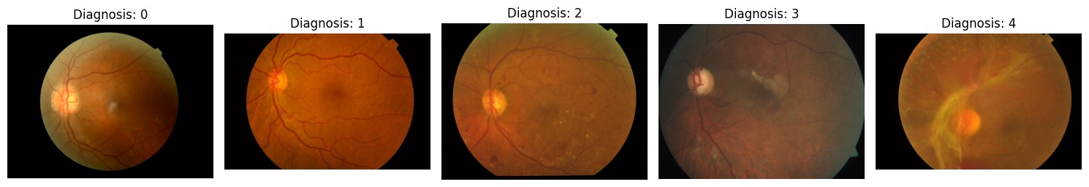
Understanding the Data
Image Dataset Insights:
Representative retinal images for each class show severity progression.
Class 0 dominates the dataset, highlighting the need for balancing.
Notes:
The image dataset provided retinal images labeled by severity. Representative images for each class showed a clear progression from healthy retinas to severe retinopathy. However, like the tabular dataset, this dataset was imbalanced, with most samples belonging to the No DR class. We addressed this imbalance during preprocessing.

Slide 6
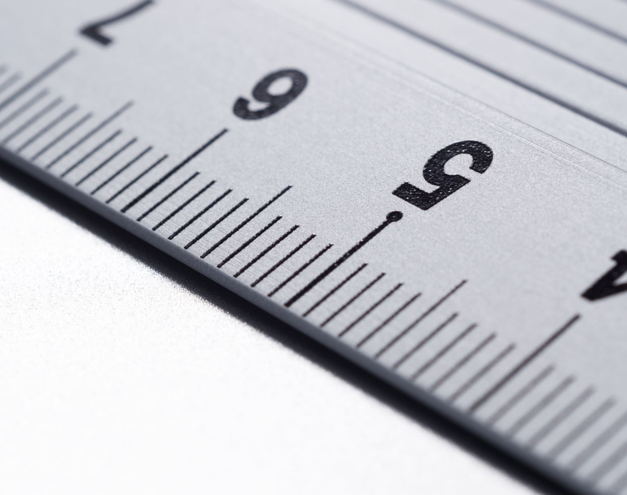
Preparing Data for Modeling
Tabular Data:
Standard Scaling for numerical features.
SMOTE to address class imbalance.
80-20 split for training and testing.
Image Data:
Resized images to 224x224.
Applied transformations (normalization, augmentation).
Used a custom PyTorch dataset for dynamic loading.
80-20 split for training and validation.
Notes:
Data preparation was a critical step. For the tabular data, we applied standard scaling to numerical features and used SMOTE to address class imbalance. For the image data, we resized the images to 224x224, applied normalization, and created a custom PyTorch dataset for efficient loading. Both datasets were split into training and testing sets using an 80-20 split.

Slide 7
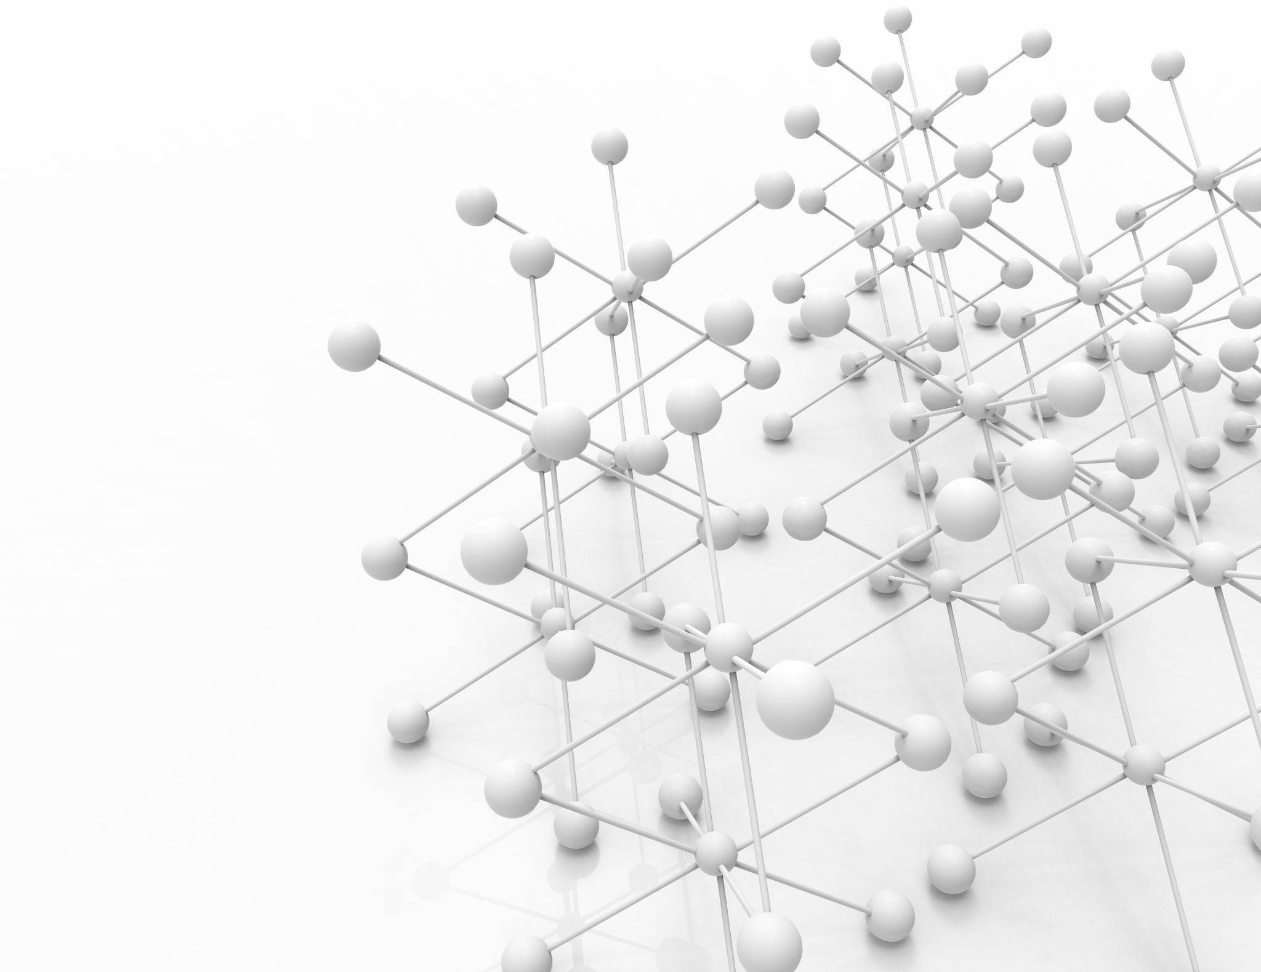
Building Predictive Models
Tabular Data Models:
Logistic Regression (Baseline).
Decision Tree, Random Forest (Best performer).
Gradient Boosting and Neural Network.
Image Data Model:
ResNet50 pretrained on ImageNet.
Replaced the fully connected layer to predict 5 classes.
Leveraged transfer learning for better performance.
Notes:
For the tabular data, we tested several machine learning models, including Logistic Regression, Decision Tree, Random Forest, Gradient Boosting, and a Neural Network. Random Forest emerged as the top performer. For the image data, we used a ResNet50 pretrained on ImageNet. We replaced its fully connected layer to predict 5 classes and leveraged transfer learning to achieve better performance on our smaller dataset.

Slide 8
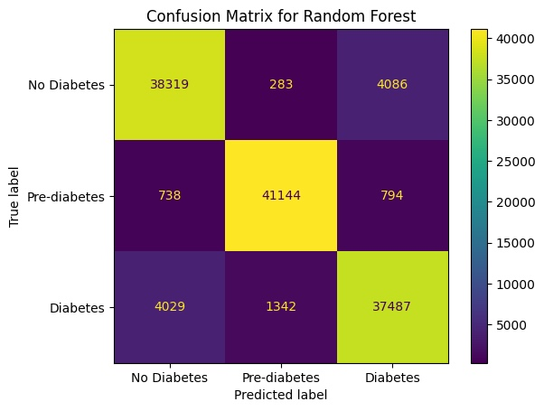
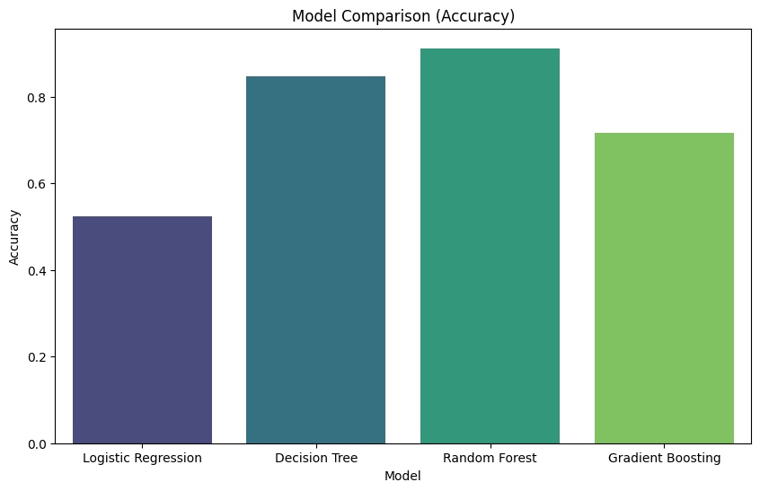
How Did the Models Perform?
Tabular Models:
Random Forest: 91% accuracy (highest).
Decision Tree: 85% accuracy.
Logistic Regression: 52% accuracy.
Gradient Boosting: 72% accuracy.
Notes:
Here are the results for the tabular models. Random Forest achieved the highest accuracy of 91%, followed by Decision Tree with 85%. Gradient Boosting and Neural Networks struggled due to the structured nature of the data, achieving 72% and 67% accuracy, respectively. These results highlight the strength of ensemble methods like Random Forest in capturing complex relationships in tabular data.

Slide 9
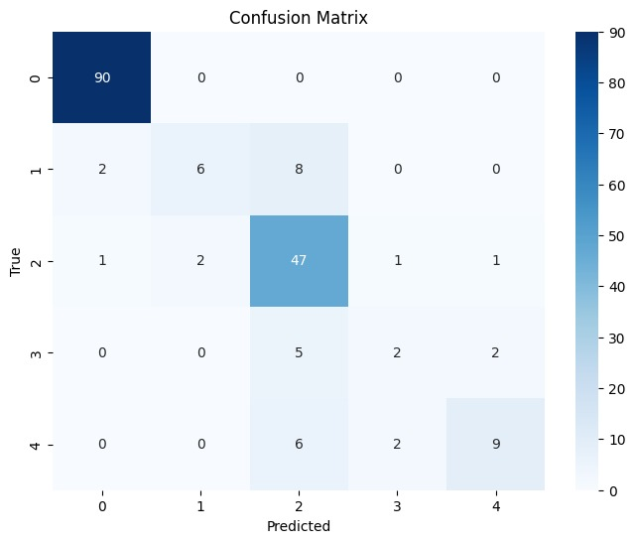
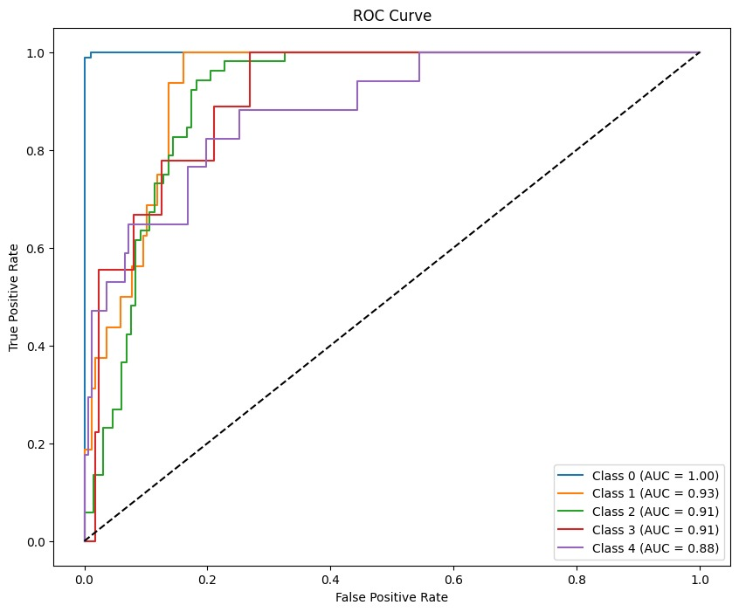
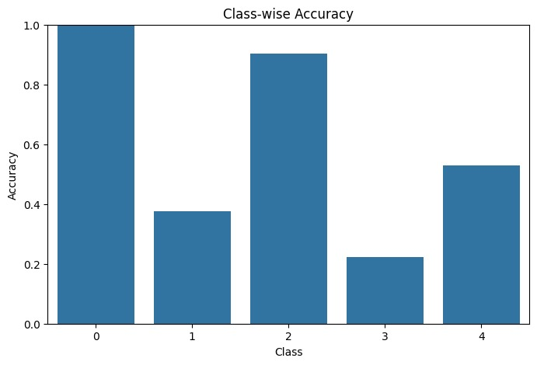
How Did the Models Perform?
Image Model:
ResNet50 achieved 82% accuracy on validation data.
ROC Curve: High AUC scores, especially for Class 0 (No DR).
Notes:
For the image data, ResNet50 achieved an accuracy of 82% on the validation set. The ROC curve for this model showed high AUC scores, especially for Class 0 (No DR), indicating strong performance. However, the model struggled with underrepresented classes like Severe and Proliferative DR, which we attribute to the dataset's imbalance.

Slide 10
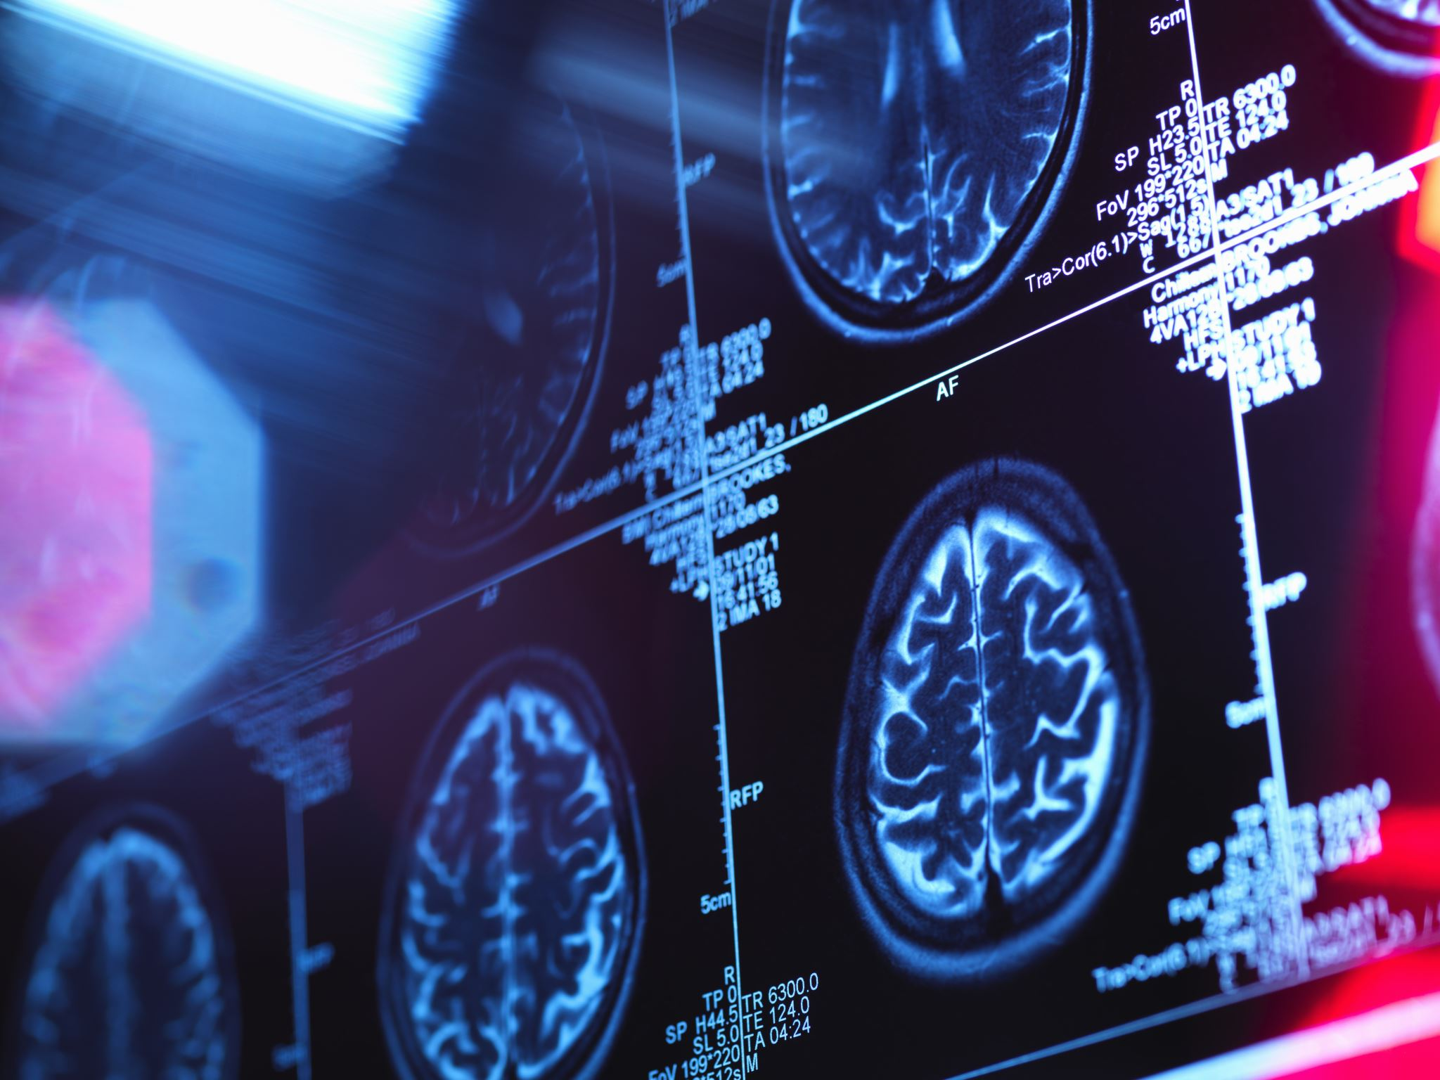
What Did We Learn?
Insights:
Tabular: BMI and HighBP are critical predictors for diabetes.
Image: Retinopathy severity is visually distinguishable with high accuracy for Class 0.
Challenges:
Class imbalance required SMOTE and weighted loss.
Neural networks struggled with tabular data due to the data's structured nature.
Notes:
From this project, we learned that BMI and High Blood Pressure are critical features for diabetes prediction, while retinal images provide clear distinctions for retinopathy severity. However, class imbalance was a significant challenge for both datasets, requiring techniques like SMOTE and weighted loss. Additionally, neural networks struggled with tabular data, confirming the effectiveness of simpler models for such datasets.

Slide 11

Looking Ahead
Achievements:
91% accuracy with Random Forest for tabular data.
82% accuracy with ResNet50 for image data.
Future Work:
Combine predictions from both datasets into a single hybrid model.
Test advanced architectures like XGBoost or TabNet for tabular data.
Explore real-world applications in healthcare.
Notes:
To summarize, we achieved 91% accuracy with Random Forest for the tabular data and 82% accuracy with ResNet50 for the image data. In the future, we plan to combine predictions from both datasets into a single hybrid model, test advanced architectures like XGBoost or TabNet for tabular data, and explore real-world applications in healthcare. This project has provided valuable insights and a strong foundation for further research.

Slide 12

Thank you
Notes:
Thank you for your attention. We’re happy to take any questions you might have.

